Slide 1
PYSPARK JOINS INTERVIEW QUESTIONS
VISIONBOARD

Slide 2
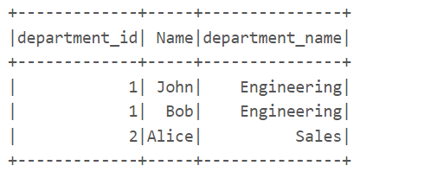
QUESTION 1:
data1 = [("John", 1),
("Alice", 2),
("Bob", 1)]
data2 = [(1, "Engineering"),
(2, "Sales")]
# Create DataFrames
df1 = spark.createDataFrame(data1, ["Name", "department_id"])
df2 = spark.createDataFrame(data2, ["department_id", "department_name"])

Slide 3
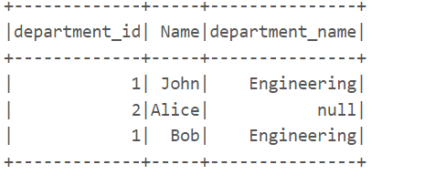
QUESTION 2:
data1 = [("John", 1),
("Alice", 2),
("Bob", 1)]
data2 = [(1, "Engineering"),
(3, "Marketing")]
# Create DataFrames
df1 = spark.createDataFrame(data1, ["Name", "department_id"])
df2 = spark.createDataFrame(data2, ["department_id", "department_name"])

Slide 4
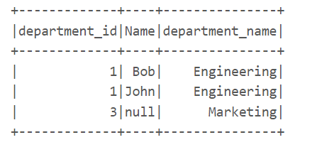
QUESTION 3:
data1 = [("John", 1),
("Alice", 2),
("Bob", 1)]
data2 = [(1, "Engineering"),
(3, "Marketing")]
# Create DataFrames
df1 = spark.createDataFrame(data1, ["Name", "department_id"])
df2 = spark.createDataFrame(data2, ["department_id", "department_name"])

Slide 5
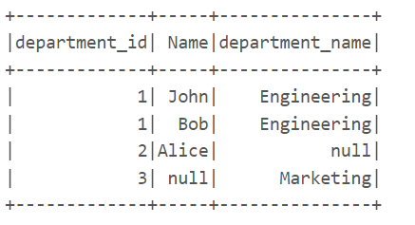
QUESTION 4:
data1 = [("John", 1),
("Alice", 2),
("Bob", 1)]
data2 = [(1, "Engineering"),
(3, "Marketing")]
# Create DataFrames
df1 = spark.createDataFrame(data1, ["Name", "department_id"])
df2 = spark.createDataFrame(data2, ["department_id", "department_name"])

Slide 6
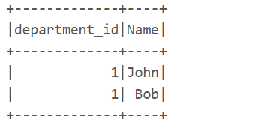
QUESTION 5:
data1 = [("John", 1),
("Alice", 2),
("Bob", 1)]
data2 = [(1, "Engineering"),
(3, "Marketing")]
# Create DataFrames
df1 = spark.createDataFrame(data1, ["Name", "department_id"])
df2 = spark.createDataFrame(data2, ["department_id", "department_name"])

Slide 7
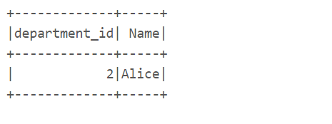
QUESTION 6:
data1 = [("John", 1),
("Alice", 2),
("Bob", 1)]
data2 = [(1, "Engineering"),
(3, "Marketing")]
# Create DataFrames
df1 = spark.createDataFrame(data1, ["Name", "department_id"])
df2 = spark.createDataFrame(data2, ["department_id", "department_name"])

